Slide 1
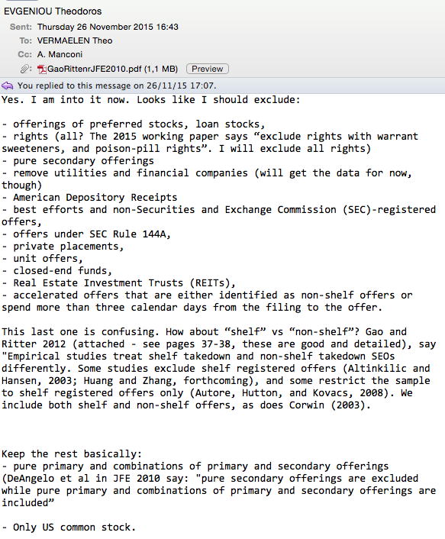

Slide 2
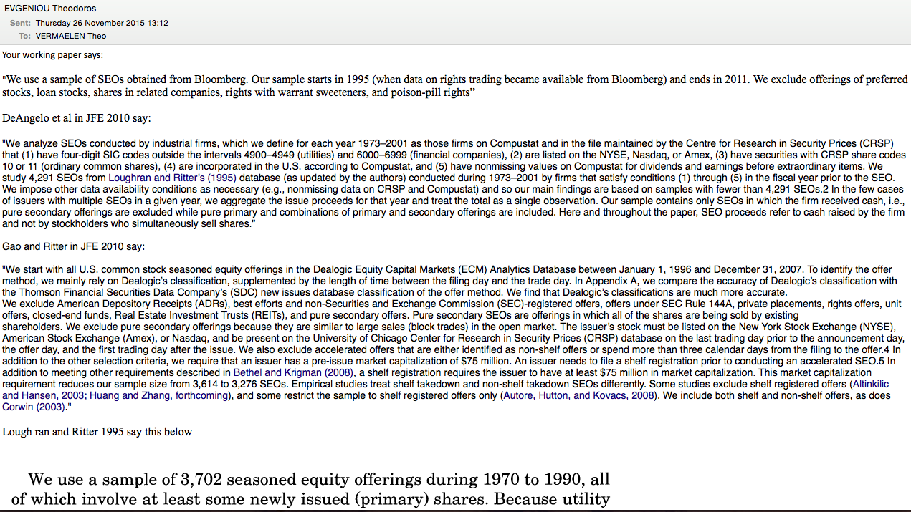

Slide 3
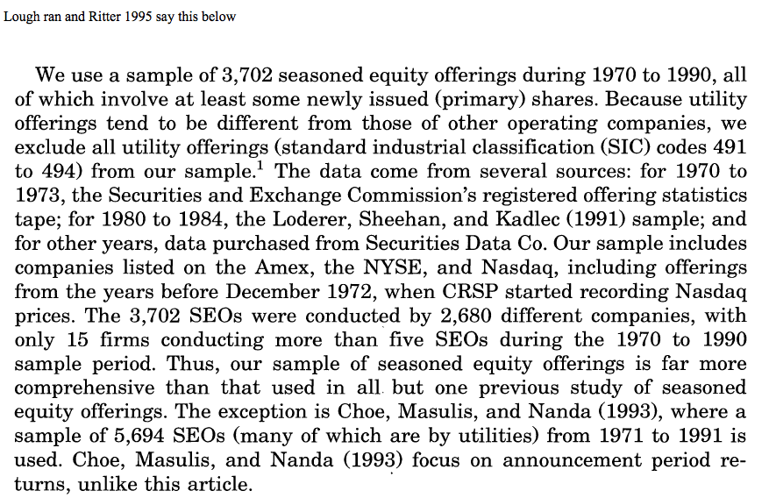

Slide 4
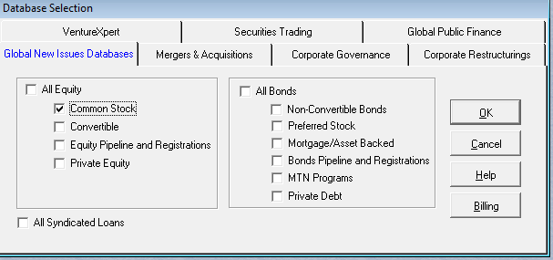

Slide 5
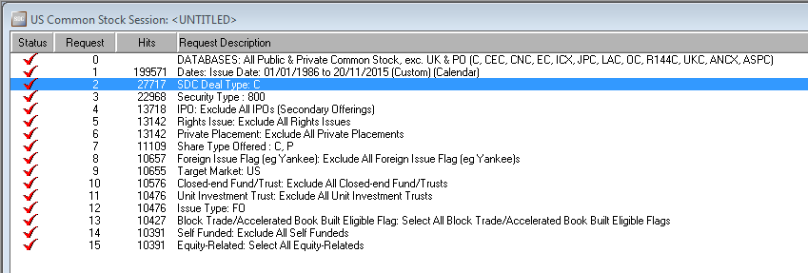

Slide 6
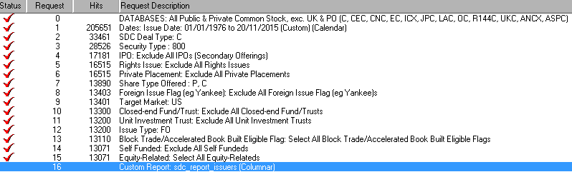
Since 1976

Slide 7
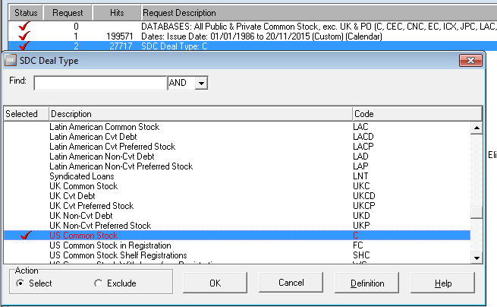

Slide 8
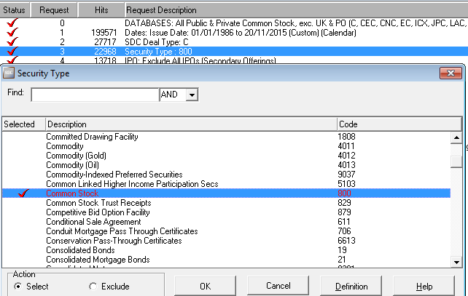

Slide 9
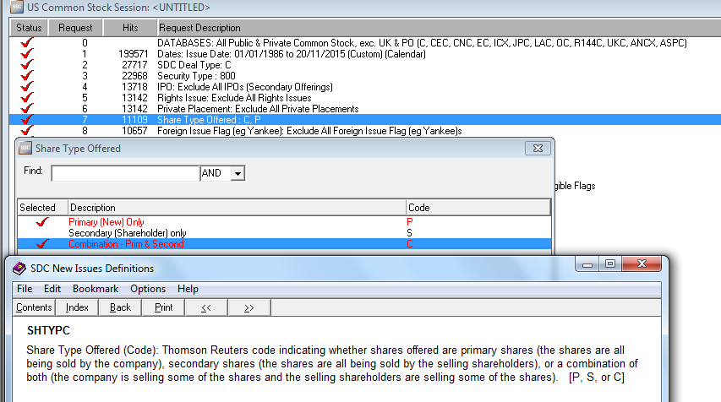

Slide 10
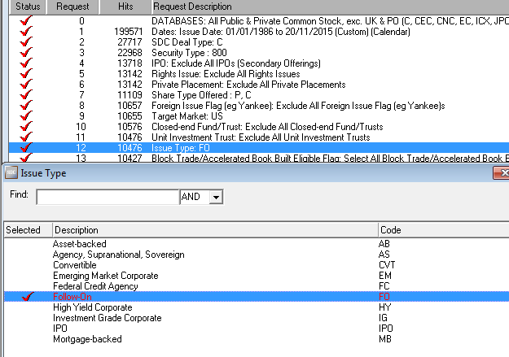

Slide 11
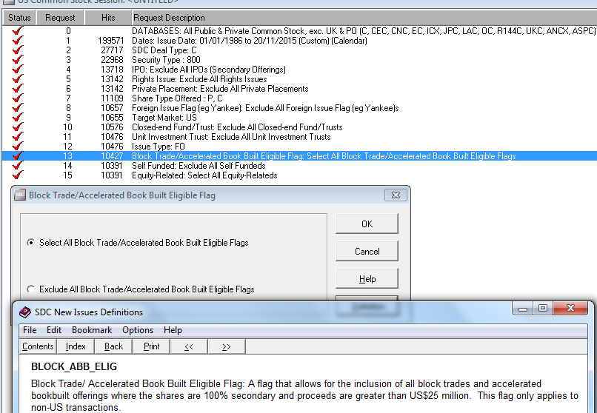

Slide 12
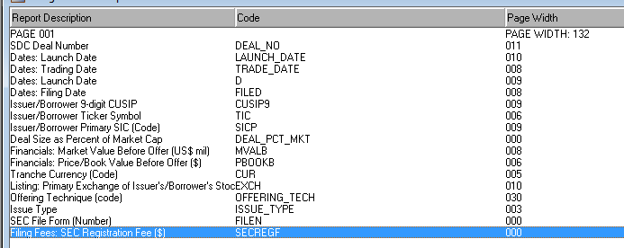

Slide 13
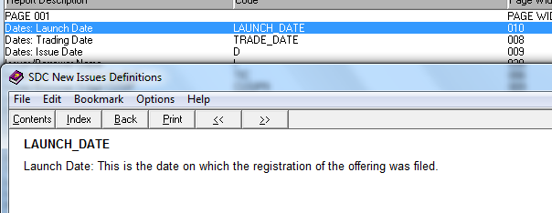

Slide 14
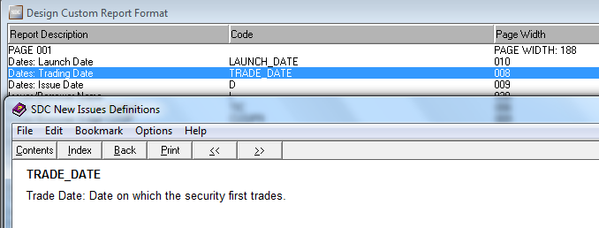

Slide 15
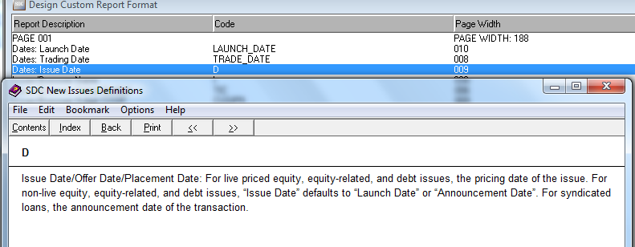

Slide 16
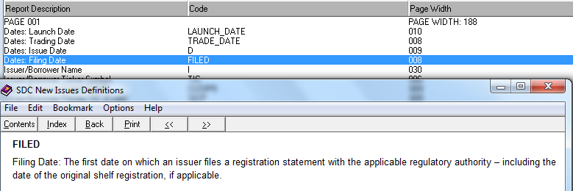

Slide 17
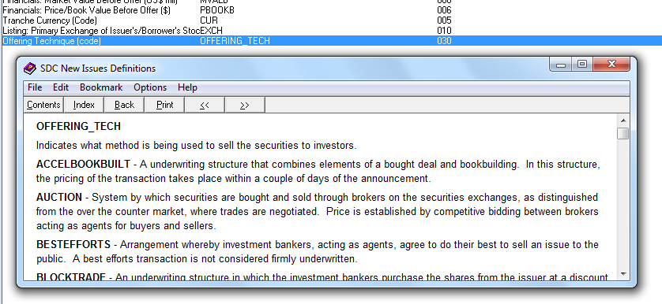

Slide 18
OFFERING_TECH
Indicates what method is being used to sell the securities to investors.
ACCELBOOKBUILT - A underwriting structure that combines elements of a bought deal and bookbuilding. In this structure, the pricing of the transaction takes place within a couple of days of the announcement.
AUCTION - System by which securities are bought and sold through brokers on the securities exchanges, as distinguished from the over the counter market, where trades are negotiated. Price is established by competitive bidding between brokers acting as agents for buyers and sellers.
BESTEFFORTS - Arrangement whereby investment bankers, acting as agents, agree to do their best to sell an issue to the public. A best efforts transaction is not considered firmly underwritten.
BLOCKTRADE - An underwriting structure in which the investment bankers purchase the shares from the issuer at a discount to the market price and re-offer the shares to investors. In this structure, the pricing of the transaction takes place within one business day.
CAPITAL - Money from a company's reserves is converted into capital, which is then distributed to shareholders as new shares (in proportion to present ownership holdings).
E*OFFERING - Deal offered online or via the Internet.
FIRMCOMMITMENT - Arrangement in which the investment bankers purchase securities from the issuer to be offered to the public. The investment bankers make their profit on the difference between the purchase price, determined through either competitive bidding or negotiation, and the public offering price.
INTERMEDRS - A placing of securities through financial intermediaries.
NEGOTIATEDSALE - Underwriting of new securities issue in which the spread between the purchase price paid to the issuer and the public offering price is negotiated rather than having competitive bidding by multiple potential underwriters.
OFFERSALE - The practice of issuing a security by public subscription. The offer is advertised widely, stipulating the terms of the issue and closing of the offer at a future date.
OFFSUBSCRP - An agreement between managers and borrowers. The managers agree to subscribe or procure subscribers for a primary market issue. The borrower agrees to issue such securities.
OPENOFFER - An invitation to existing holders of securities to purchase or subscribe for securities in proportion to their existing holdings. This subscription is not made by means of a renounceable letter.
PLACEMENT - Direct sale of securities to institutional investors (private placement transactions).
RIGHTS - Offering of common stock to existing shareholders who hold rights that entitle them to buy newly issued shares at a discount from the price at which shares will later be offered to the public.
SELLOFF - Selling securities or commodities under pressure to avoid further declines in prices. Sell off is also called 'dumping'.
SPECIALWARRANTS - Special intermediary security that is used to offer shares to the public. It allows the issuer to receive a portion of the deal's proceeds while the agent qualifies the prospectus and arranges investors. Final payment of proceeds occurs when the final prospectus is filed and the special warrants are exchanged for the underlying security of the deal (Canadian specific).
TENDER - Offer to buy shares of a corporation, usually at a premium above the market price, for cash, securities, or both. The objective of issuing a tender offer is to take control of the target company.
VENDORPLCG - A marketing by or on behalf of vendors of securities. The securities have been allotted to them as consideration for an acquisition of assets or consideration for future business.

Slide 19
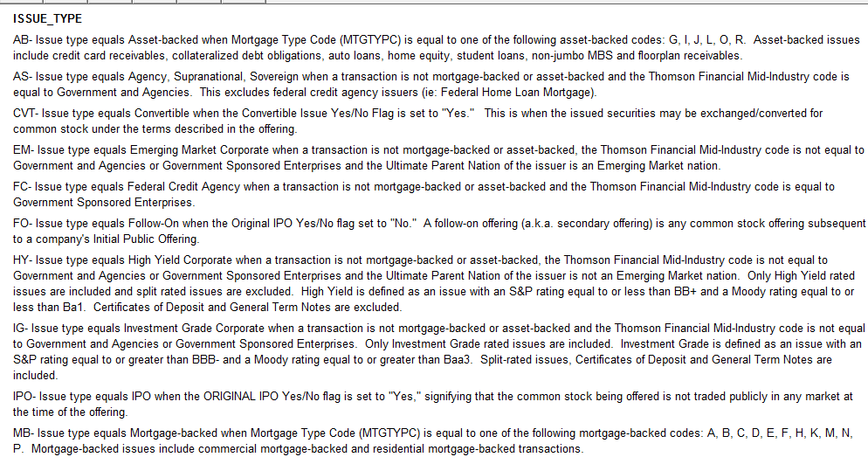

Slide 20
